Slide 1
Color Me Informed
Sean Oslin
4/14/20

Slide 2
Agenda
What is color?
Preattentive attributes
How we use color
Color theory
Tips on using color

Slide 3
Color is the aspect of things that is caused by differing qualities of light being reflected or emitted by them.
-- Crayola
Notes:
To see color, you have to have light. When light shines on an object some colors bounce off the object and others are absorbed by it.
Our eyes only see the colors that are bounced off or reflected.
Color is a preattentive attribute.

Slide 4
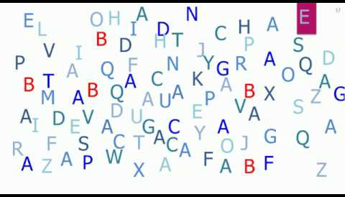
What are preattentive attributes?
Pre - before
Attentive - notice on a conscious level
Attributes - characteristics
Notes:
Definition: Visual property which is processed in memory without our conscious action. For example, what is the first thing that catches your eye in image to the right?
Or, what your eye is drawn to, like the pink highlighted letter E in the image
And, FAST!

Slide 5
Your brain is fast….
Notes:
Your brain to responds to preattentive attributes in half a second.
Time enough to react without thinking. Time to make a split-second decision.
Think: instinctive or automatic response: like braking for a red light. Or, a dog seeing a squirrel.

Slide 6
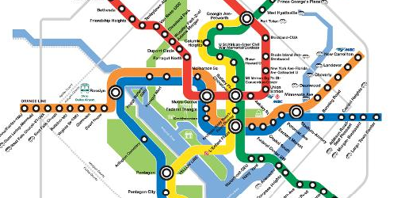
Why do we use color? http://understandinggraphics.com/design/10-reasons-to-use-color/
1. To speed visual search (direct the eye)
Notes:
The website link is for 10 Reasons to Use Color. It offers great examples of why we want to use color. Here are 3 examples.
Visual search: Color helps us separate visual elements from their surroundings.

Slide 7
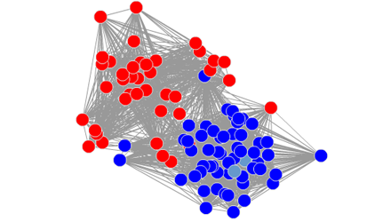
8. To communicate mood
9. To show associations
Notes:
To communicate mood: more about that later.
To show associations, such between nodes in this network analysis

Slide 8
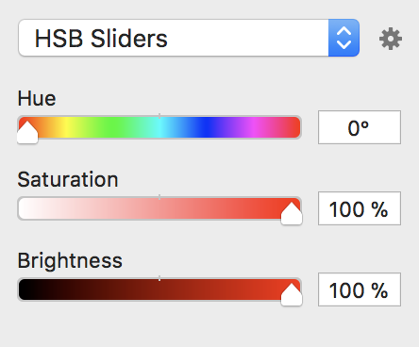
Color properties: 3 elements
Notes:
Color is comprised of 3 elements.
Hue is a measure of the color that we give a name to such as “Red” or “Violet”. Rainbow names.
Saturation is the amount of gray in a hue.
Brightness (lightness/value) is the amount of black or white in a hue
Saturation and brightness collectively are called color intensity.

Slide 9
Hue
Notes:
Hue is the easiest color concept to understand.

Slide 10
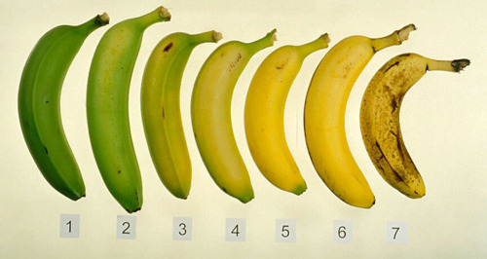
Hue: how ripe do you like bananas?
Notes:
Example of how hue changes during the ripening process.
What number represents your ideal eating banana? Making banana bread?

Slide 11
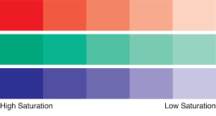
Saturation
Notes:
Color saturation is the amount of grey in a hue.

Slide 12
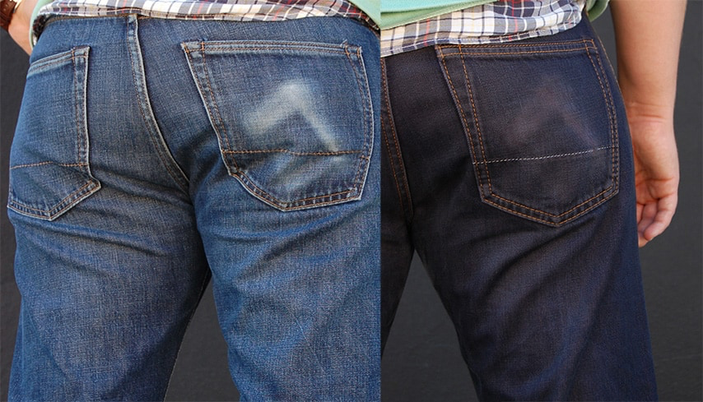
Saturation: same hue, different saturation
Notes:
Maximum saturation is pure color. Minimum is washed out, faded - gray. No matter how many times you wash your blue jeans, they will never be white.

Slide 13
Brightness/lightness/value
Notes:
After Hue, brightness is the color property that our eyes are most sensitive to.
Brightness is also called lightness and value. With apologies to Michael Jackson, it does matter if your black or white.

Slide 14
Notes:
Brightness is the relative lightness or darkness of a particular color, from black (no brightness) to white (full brightness).
The difference between color saturation and color brightness is very important in photography and image processing applications.
The takeaway: if you want turn a blue sky grey, lessen the saturation. If you want to make a dark blue sky a lighter shade of blue, decrease the brightness.

Slide 15
Notes:
Example of brightness: where does your eye go in this movie still.
Cary Grant in Alfred Hitchcock’s Suspicion (1941)

Slide 16
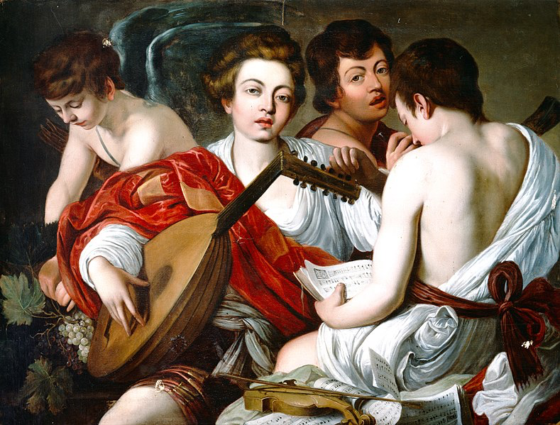
The Musicians (1597)
Caravaggio
Notes:
Here is another example of brightness. The Baroque-era painter Caravaggio was an absolute master of light. If you seen one of his paintings in a museum, you will swear that it is backlight. His paintings seem to glow. The brightness of the central character draws you to his face. The read shawl provides contrast to the whiteness of the musicians and also helps focus your attention on the central character.

Slide 17
Tips on using color
Notes:
Question: What movie is this from?

Slide 18
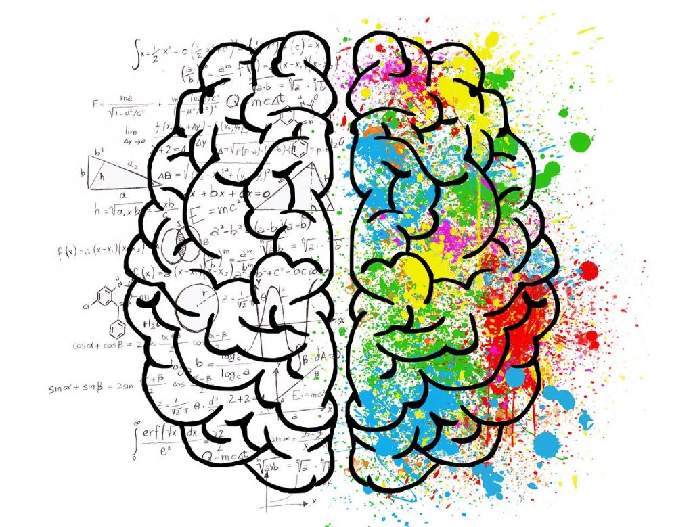
Psychology of color
Presence OR absence can influence mood
Personal and cultural differences
Works in conjunction with other pre-attentive attributes (e.g. red line moving downward)
Is context dependent (stoplight vs. Valentine’s Day)
No consensus on impact!
Notes:
https://www.verywellmind.com/color-psychology-2795824

Slide 19
Notes:
Here are two examples of how colors may be interpreted. Note the differences. That is why it is important to test colors with people who resemble you target audience.

Slide 21
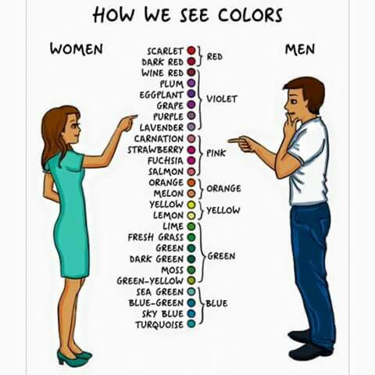
Notes:
This is somewhat tongue in cheek. As I mentioned before, the important thing is to check your color selection with a variety of people. Always keep your customer in mind.

Slide 22
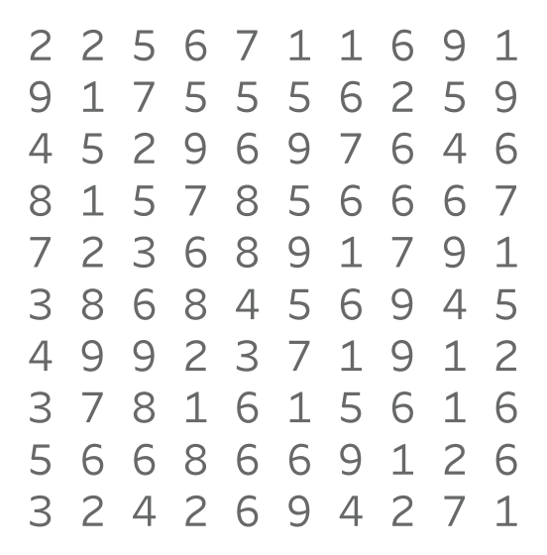
Color highlights important points: How many 9s?
Notes:
Color helps as pick details out of a crowd.

Slide 23
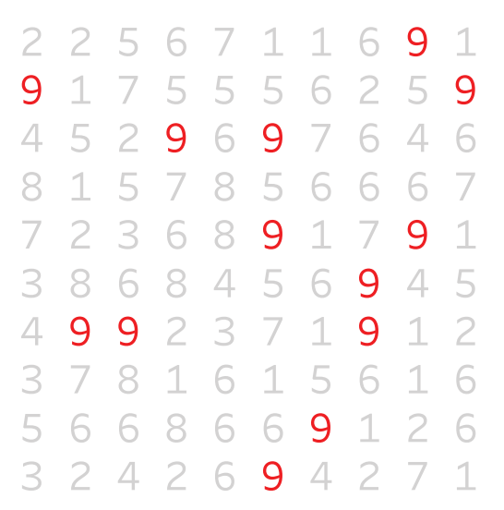
Easier?
Notes:
Our eyes are drawn to the color: it’s a preattentive attribute.
You see this technique used in crowd scenes in TV shows and movies, like the image from the Matrix at the start of this section.

Slide 24
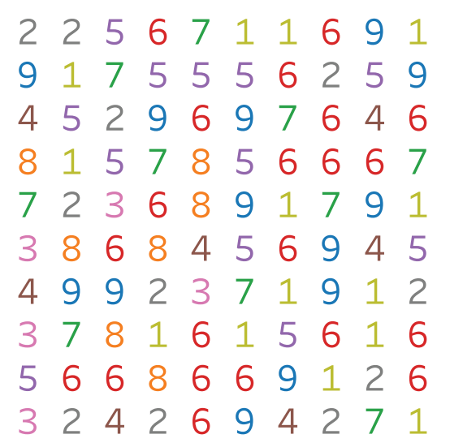
How about now?
Notes:
Too much color is as bad as none at all. Our eyes have a hard time settling on the 9s.
Remember: We’re not playing Where’s Waldo.

Slide 25
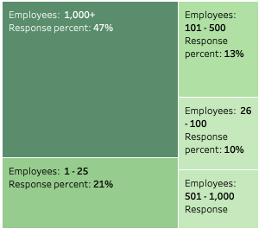
Use color intensity to convey information
Notes:
Why does color intensity matter?
Our eyes are drawn to pure, intense colors. Also, using a continuum of intensity for a single color allows us to add variety to a presentation without overwhelming our eyes with too many hues.
In this example, intensity is coupled with geometric area to convey information about the relative strength/size/importance of each data element.
Color intensity is used as a continuum with the darkest color being the largest portion and the lightest color being the smallest

Slide 26
Use color sparingly
Notes:
Colors are for emphasizing or accenting the story you want to tell. Use sparingly! You are not creating art.
Also, note the color used in the ‘After’ graph is muted, less intense than the ‘Before’ colors. Using bright, rainbow colors can be the same as typing in ALL CAPS!

Slide 27
Black
Nigel: “It's like, how much more black could this be and the answer is none. None more black.” This is Spinal Tap
Notes:
Black used on a white background is an accent color. Use sparingly for visualizations. There are lots of shades of grey you can use for text and reference lines.
Using shades of grey gives the illusion of foreground and background to your visualization.

Slide 28
Appropriate use of colored background
Notes:
Except of unusual situations avoid any strongly colored backgrounds.

Slide 29
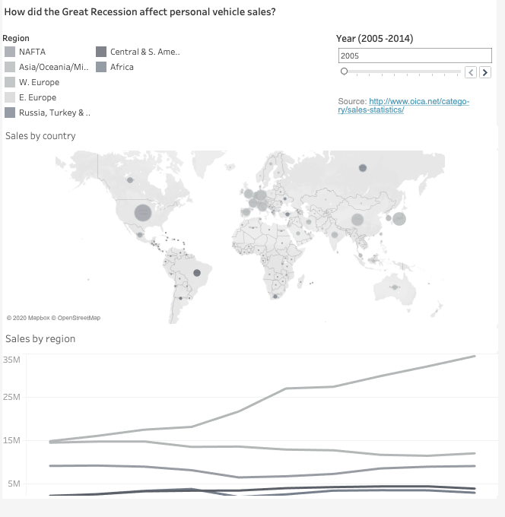
Grey is your friend
Notes:
When I create a draft of a data viz for a client, I only use grayscale colors at first.
Customers often become preoccupied with color choice and forget the substance of the graph.
Take color out of the mix to help focus their attention on the content.

Slide 30
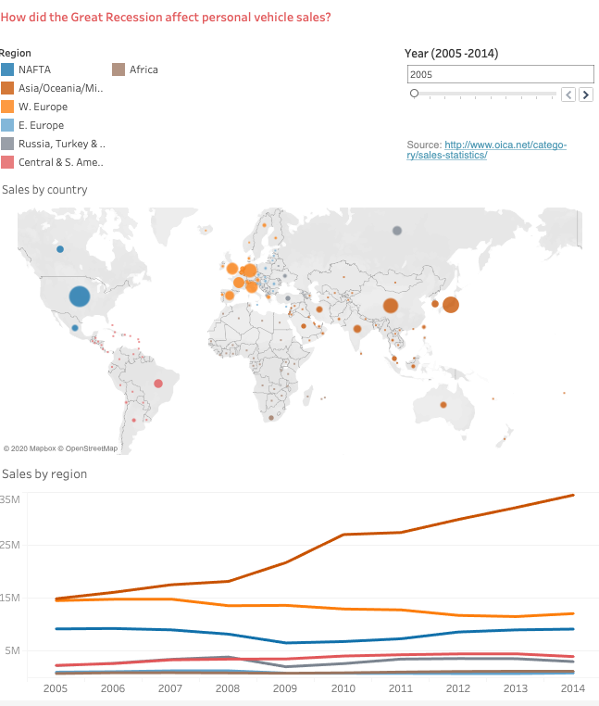
Add color after the design has been finalized

Slide 31
Notes:
Contrast gives a sense of balance (red/blue, orange/purple)

Slide 32
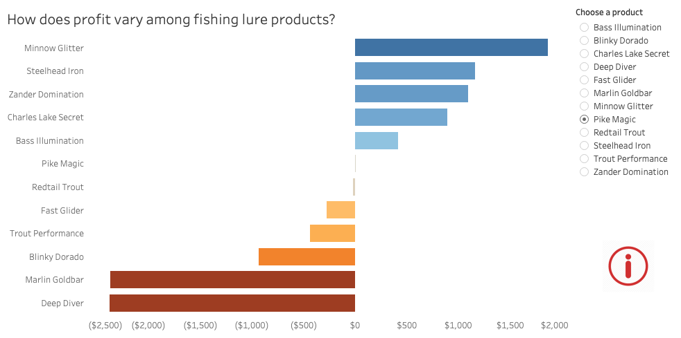
Notes:
Here is an example of color contrast: a divergent color-blind pallet shows relative size of the values, and positive and negative values. A good rule of thumb is, the more elements you have in a graph, the less intense the colors should be. Imagine what this graph would look like with rainbow questions.

Slide 33
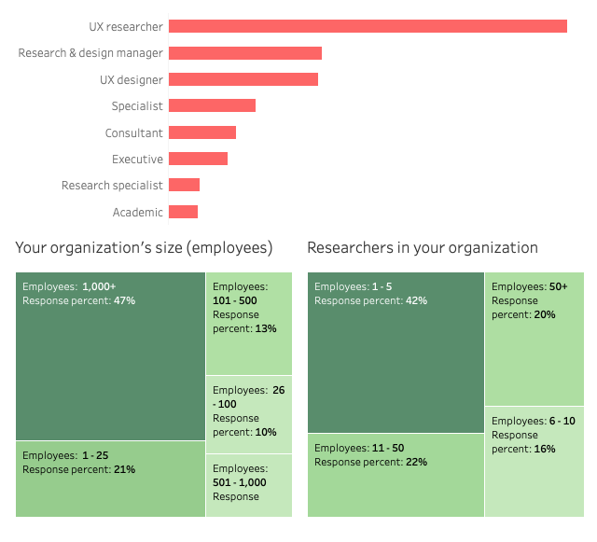
Color code your graph types
Notes:
Assigning colors to certain chart types adds continuity to visualizations. You are helping the viewer quickly to interpret what you are trying to communicate

Slide 34
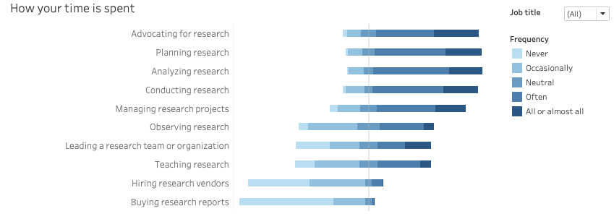
Color scheme & sequential data
Notes:
We’ve talked about individual colors. Now, let’s talk about color schemes. Color schemes are arrangements or combinations of colors. Color schemes may be your choice or be assigned based on corporate marketing requirements.
Nearly all data can be categorized in one of three types—sequential, divergent, and qualitative. Each type is suited to a different color scheme.
Sequential data are best displayed with a palette that varies uniformly in intensity.
The Likert charts in this slide are an example of this. Adjusting the color intensity makes the vizz easier on the eyes as well is readily intelligible.

Slide 35
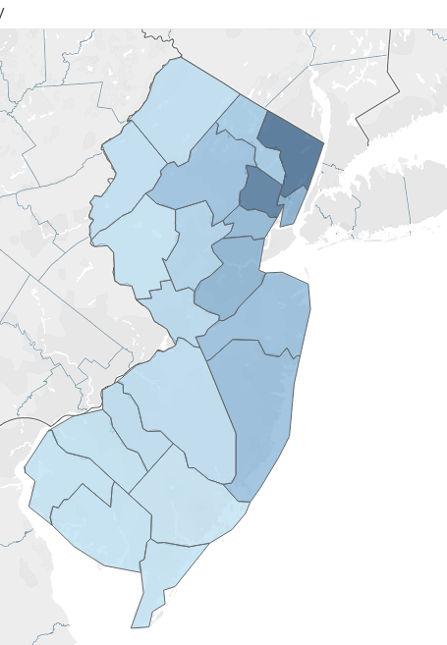
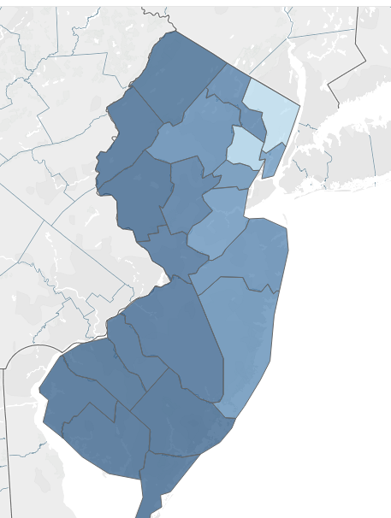
Deaths from Covid-19 in New Jersey
How would you interpret these two maps?
Notes:
Order is important. Usually the data that is most important, largest, most severe should be in the darkest color. You can easily mislead people with color. Be careful. Be ethical.

Slide 36
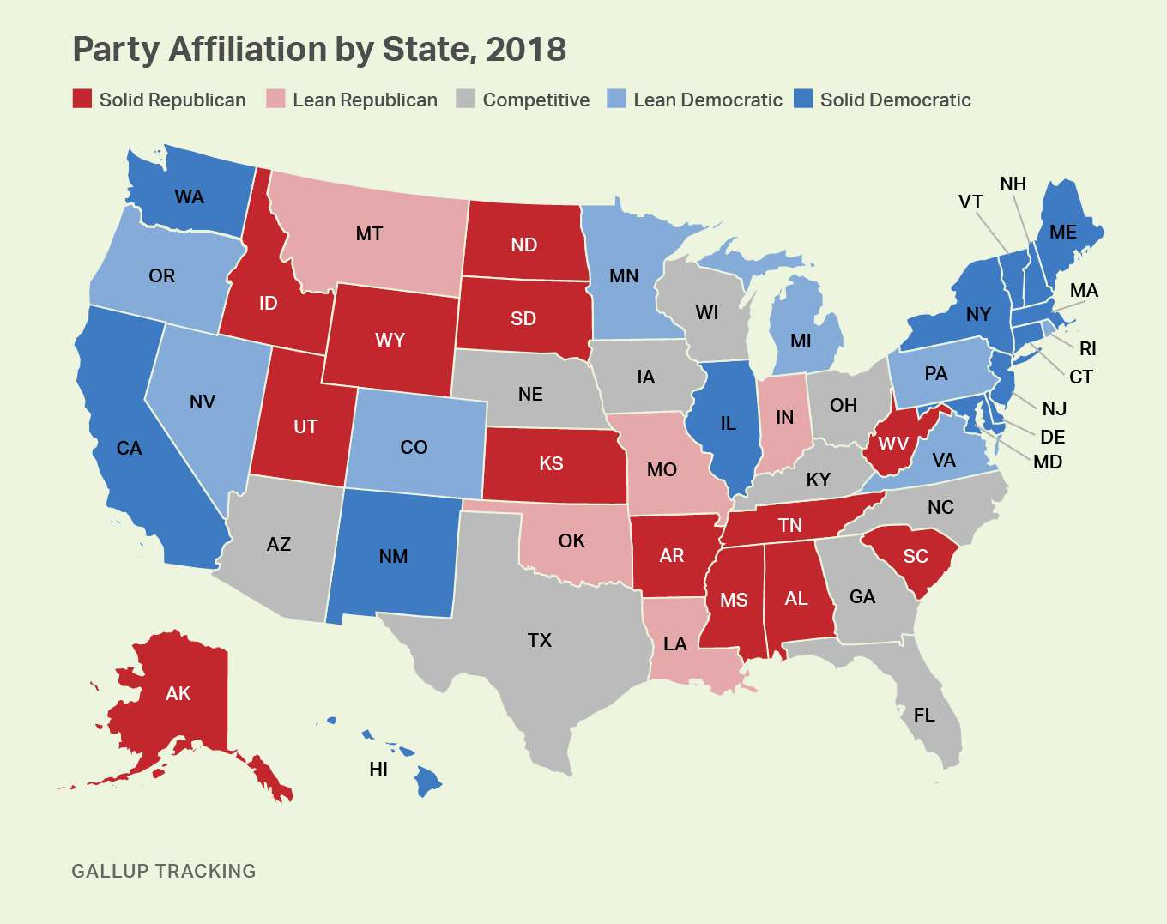
Color schemes & divergent data
Notes:
Divergent data, such as political party affiliation, is suited to bifurcated palettes with a neutral central color.
In this case the two ends of the scheme are red and blue. The central, neutral color is grey.

Slide 37
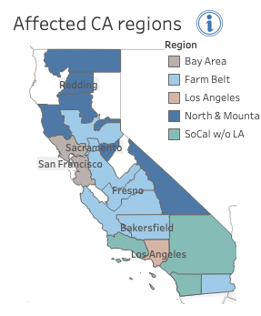
Color schemes and qualitative/categorical data
Notes:
Qualitative data benefits from a set of easily distinguishable colors. Again, notice the muted intensity of the colors.

Slide 38
Color blindness
Notes:
Color blindness affects approximately 1 in 12 men (8%) and 1 in 200 women in the world. There are 3 types (only 2 are shown here), with red-green being the most common.
Be aware of this when combining colors for a graph.

Slide 39
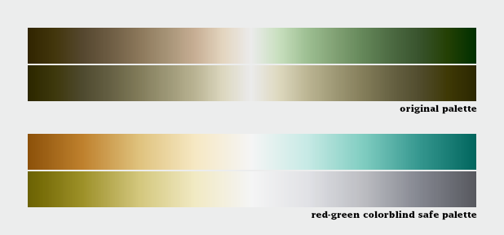
No good & good color palettes for color blindness
Notes:
Here are examples of divergent color palettes. The second replaced the first because of issues with colorblindedness.
The point is that colorblindedness is not limited to pure reds and greens, but a variety of colors comprised of reds and greens.
Visualization software packages have color-blind palettes. I use these frequently.

Slide 40
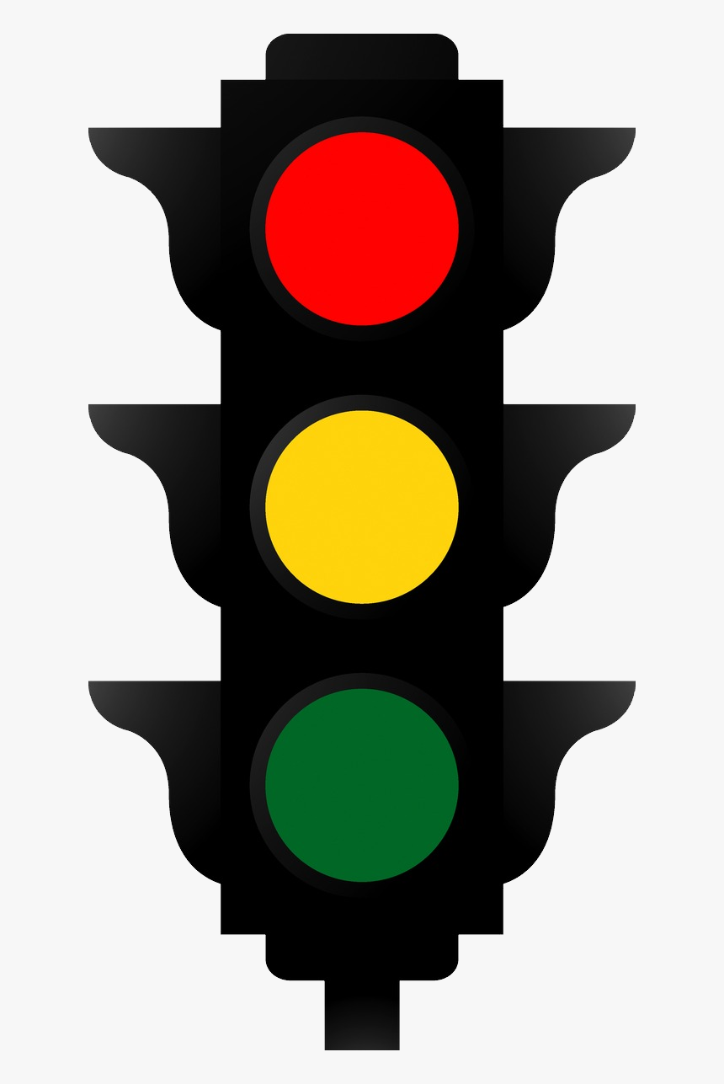
Stop!
Do not use stoplight colors!
Notes:
Do not use red and green together on the same graph. You can use these colors on separate graphs.
The stoplight motif is frequently used to measure individual and group performance. This is a bad practice. In our culture the stoplight motif is emotionally charge (green is success and red is failure). Select other contrasting colors or use single color gradient to express differences in performance.

Slide 41
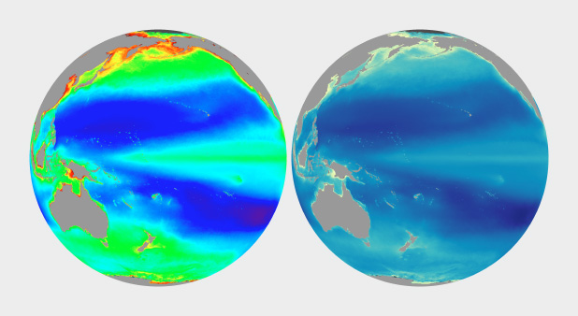
Use colors that are easy to interpret
Notes:
Both globes show variations in water temperature. The one on the left is the color scheme used by scientists. The one on the right is used by lay people. Keep your customer in mind.

Slide 42
Takeaways
Always keep your customer in mind!!!!!!
Colors are for emphasis/accent - use sparingly
Black is an accent color - use grays for text and background lines
Use a color scheme appropriate to the data
Design your visualization first and then add color
Contrast gives a sense of balance (red/blue, orange/purple)
Color code your visuals to the type of graph

Slide 43
More takeaways
Be aware of colorblindness and the emotional impact of colors - no stoplight colors
Use color to enhance the truth
Develop your own color style, but vary it based on context
Use your employer’s color palette, but still try to apply best practice
Be conservative, use (develop!) some taste
Most rules can be broken, every now and then

Slide 44
Really, really good articles!
Elegant Figures - Subtleties of Color (Part 1 of 6)
10 Reasons to Use Color
Preattentive Visual Properties and How to Use Them in Information Visualization
How to Use Color Blind Friendly Palettes to Make Your Charts Accessible

